Slide 1
Processes
Yubin Xia
IPADS, SJTU
ACKs: Some slides are adapted from the MIT’s 6.828

Slide 2
Outline

Slide 3
Processes Outline
Process Concept
Process Scheduling
Operations on Processes
Interprocess Communication
Examples of IPC Systems
Communication in Client-Server Systems

Slide 4
Process: Big Picture
More programs than processors
How to share the limited number of processors among the programs?
Observation: most programs do not need the processor continuously
because they frequently have to wait for input (from user, disk, network, etc.)
Idea: when one program must wait, it releases the processor, and gives it to another program

Slide 5
Threads
Mechanism: thread of computation, an active computation.
A thread is an abstraction that contains
the minimal state that is necessary to stop an active and resume it at some point later
The state is depends on the processor
On x86, it is the processor registers

Slide 6
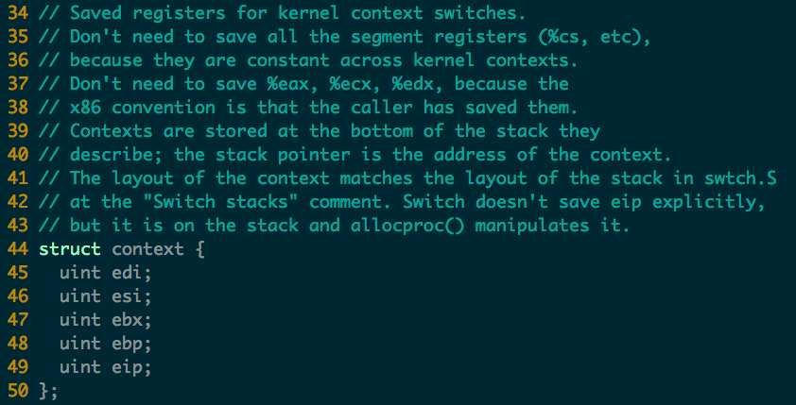
Threads in xv6

Slide 7
Address spaces and threads
Address spaces and threads are in principle independent concepts
One can switch from one thread to another thread in the same address space
or one can switch from one thread to another thread in another address space

Slide 8
Process Concepts
Process: a program in execution
one address space + one or more threads of computation
A process includes:
program counter, stack, data section
In xv6 all user programs contain one thread of computation and one address space

Slide 9
Process State
As a process executes, it changes state
new: The process is being created
running: Instructions are being executed
waiting: The process is waiting for some event to occur
ready: The process is waiting to be assigned to a processor
terminated: The process has finished execution
In xv6
Notes:
Embryo: 萌芽, 初期

Slide 10
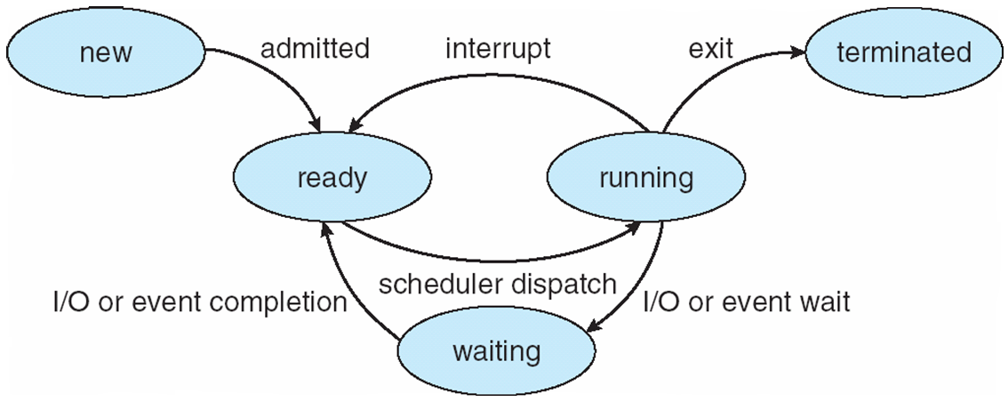
Diagram of Process State

Slide 11
Process Control Block (PCB)
Information associated with each process
Process state
Program counter
CPU registers
CPU scheduling information
Memory-management information
Accounting information
I/O status information

Slide 12
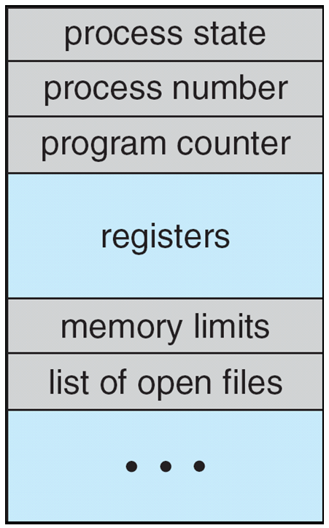
Process Control Block (PCB)

Slide 13
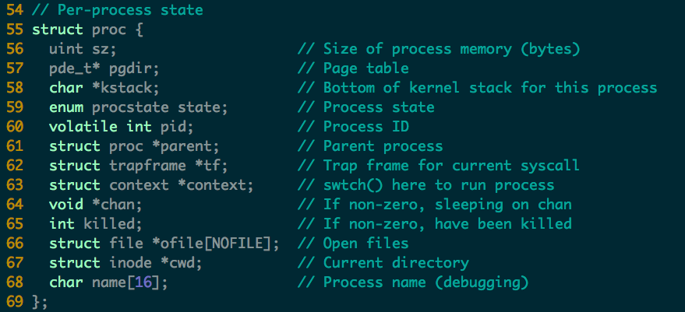
Process in xv6 (proc.c)

Slide 14
Context Switch
When CPU switches to another process, the system must do it via a context switch
save the state of the old process
load the saved state for the new process Context of a process represented in the PCB
Context-switch time is overhead
the system does no useful work while switching
Time dependent on hardware support

Slide 15
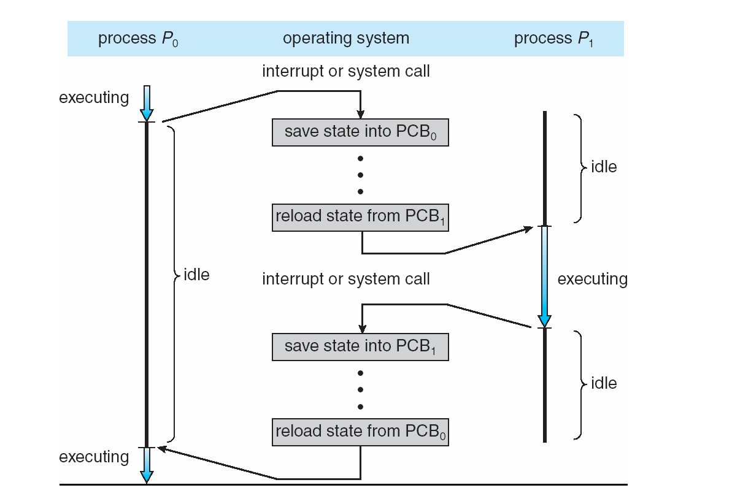
CPU Switch From Process to Process

Slide 16
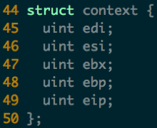
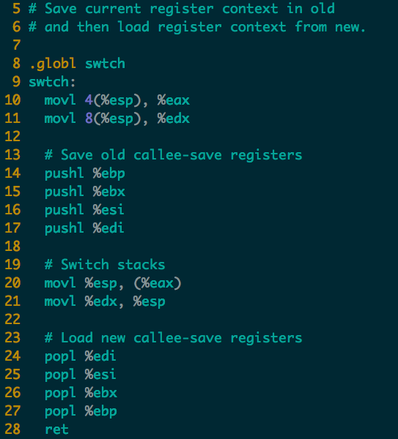

Context Switch in xv6 (swtch.S)
push
pop
new
new
old
old
ret addr
ret addr
ebp
ebp
ebx
ebx
esi
esi
edi
edi
esp
esp
Notes:
Note that the 4 pushl will generate a struct context. One missing field is eip, where is it?
Where is the old context saved?

Slide 17
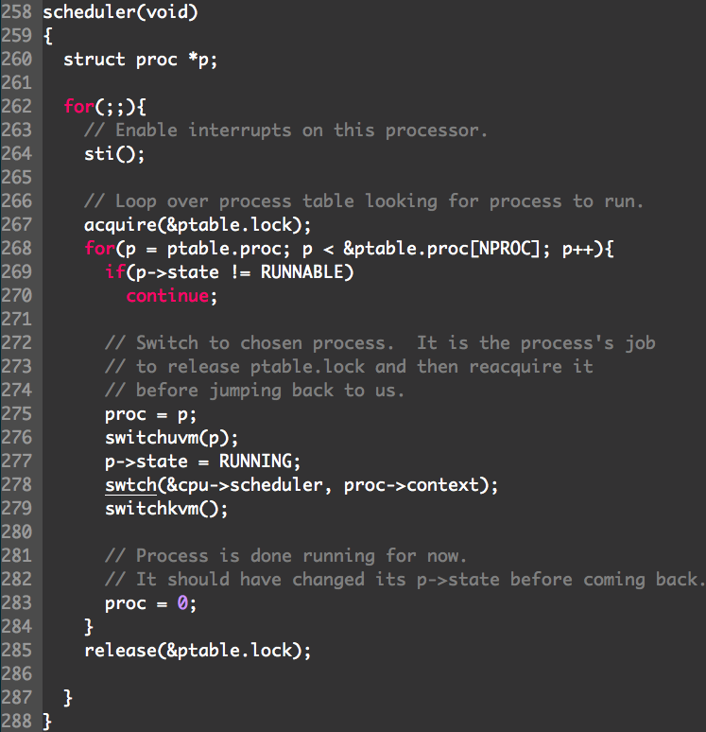
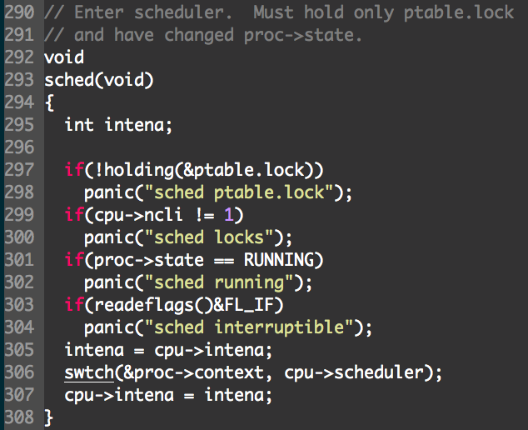
User space
User -> kernel -> user
Notes:
sched => switch to Scheduler => switchkvm (to kernel) => switchuvm (to user) => switch to P => sched

Slide 18
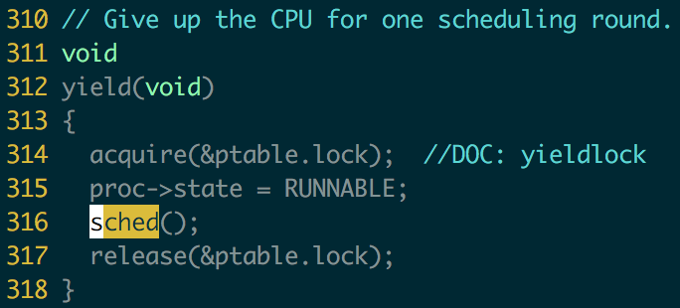
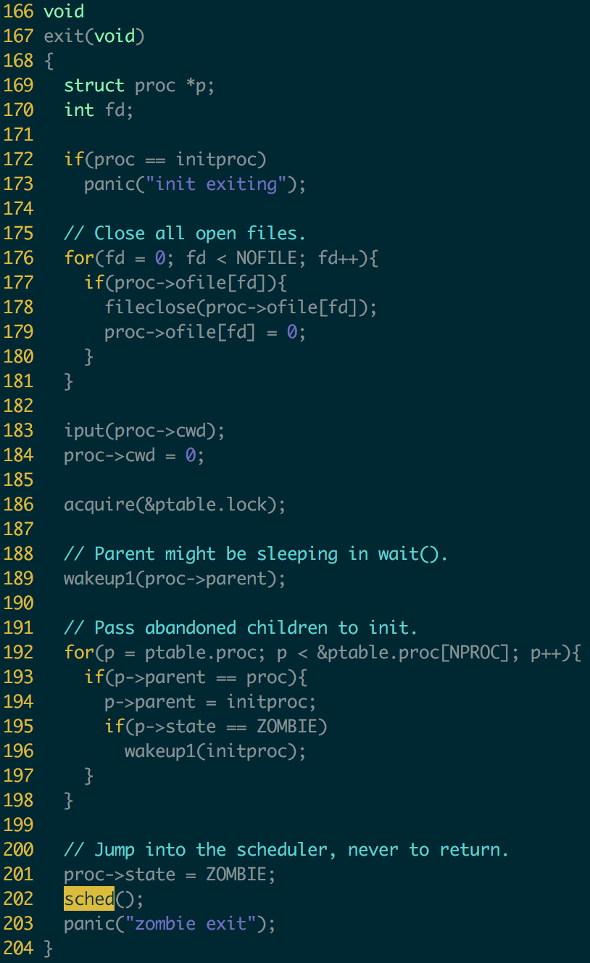
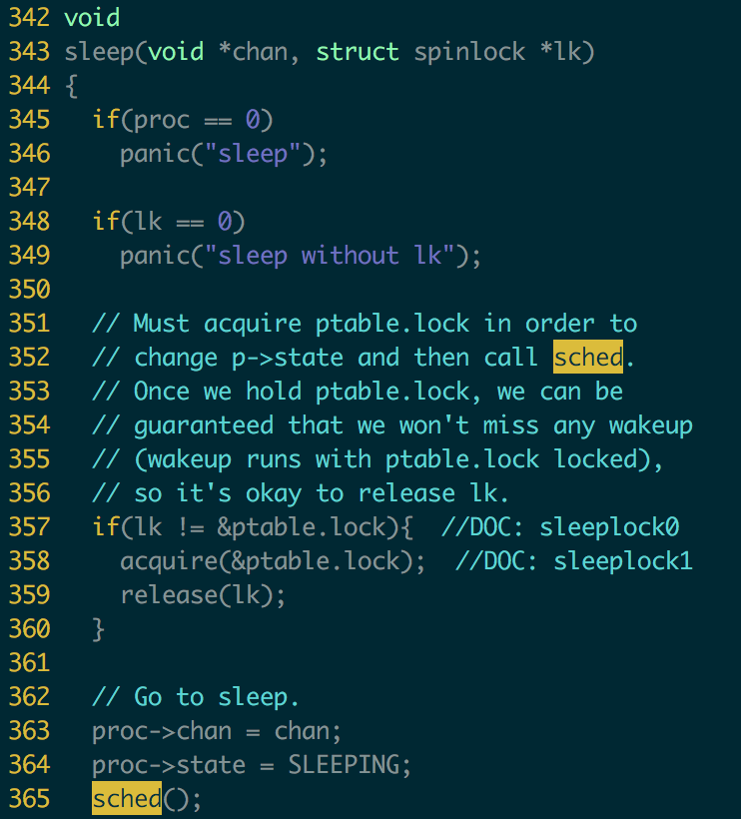

Slide 19
Process Scheduling Queues
Job queue – set of all processes in the system
Ready queue – set of all processes residing in main memory, ready and waiting to execute
Device queues – set of processes waiting for an I/O device
Processes migrate among the various queues

Slide 20
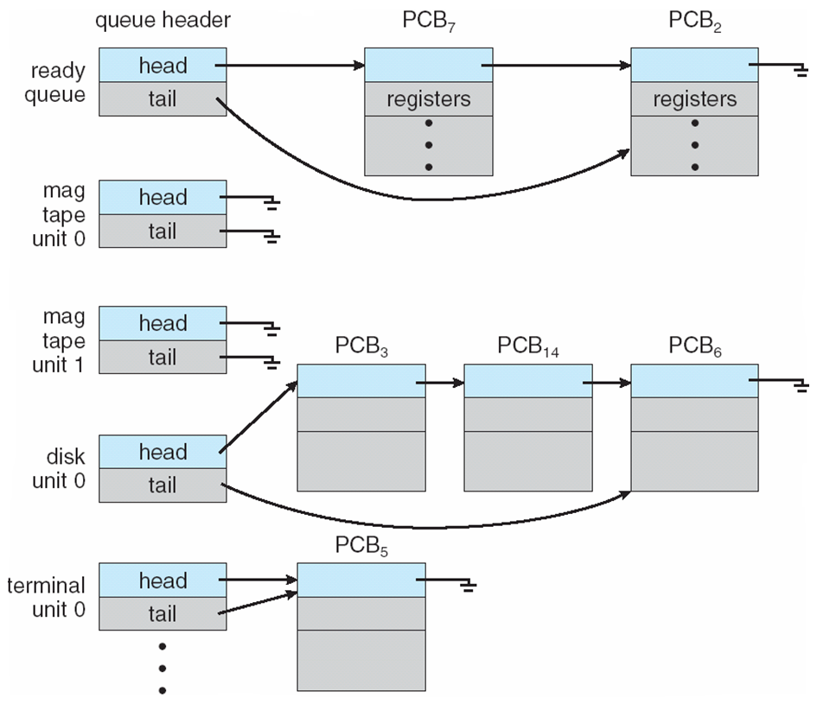
Ready Queue & Various I/O Device Queues

Slide 21
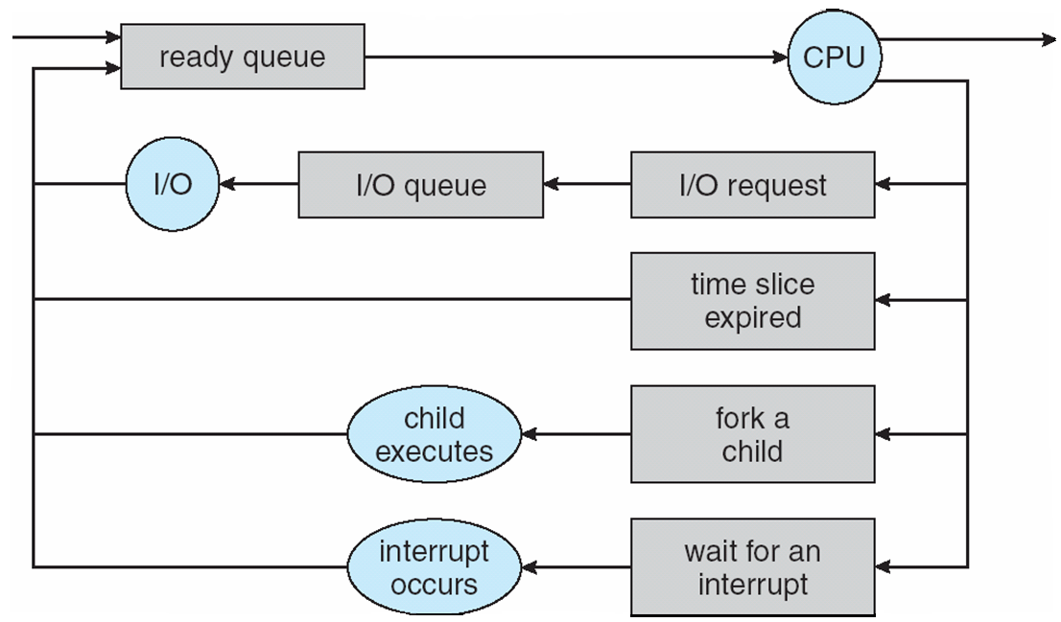
Representation of Process Scheduling

Slide 22
Schedulers
Long-term scheduler (or job scheduler) – selects which processes should be brought into the ready queue
Short-term scheduler (or CPU scheduler) – selects which process should be executed next and allocates CPU

Slide 23
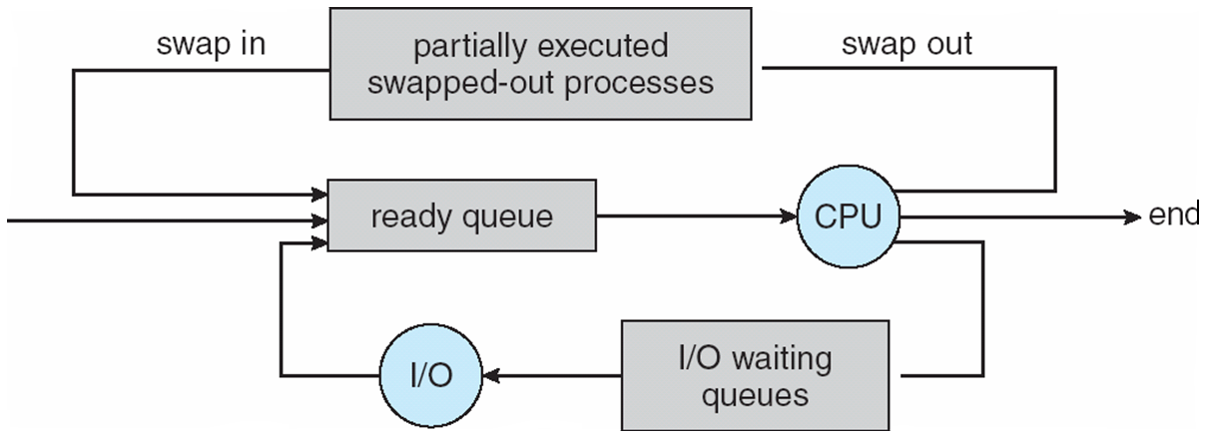
Addition of Medium Term Scheduling

Slide 24
Schedulers (Cont)
Short-term scheduler is invoked very frequently (milliseconds) ⇒ (must be fast)
Long-term scheduler is invoked very infrequently (seconds, minutes) ⇒ (may be slow)
The long-term scheduler controls the degree of multiprogramming

Slide 25
Scheduler (cont.)
Processes can be described as either:
I/O-bound process – spends more time doing I/O than computations, many short CPU bursts
CPU-bound process – spends more time doing computations; few very long CPU bursts

Slide 26
Process Creation
Parent process create children processes
forming a tree of processes
Generally, process identified and managed via a process identifier (pid)
Resource sharing policies
share all resources
share subset of parent’s resources
share no resources

Slide 27
Process Creation (Cont)
Execution
Parent and children execute concurrently
Parent waits until children terminate
Address space
Child duplicate of parent’s
Child has a program loaded into it
UNIX examples
fork system call creates new process
exec system call used after a fork to replace the process’ memory space with a new program

Slide 28
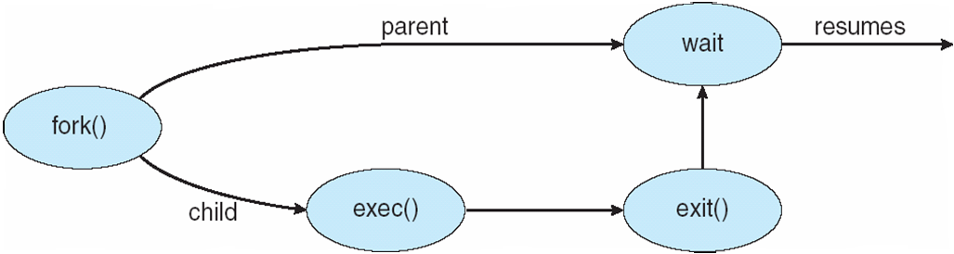
Process Creation

Slide 29
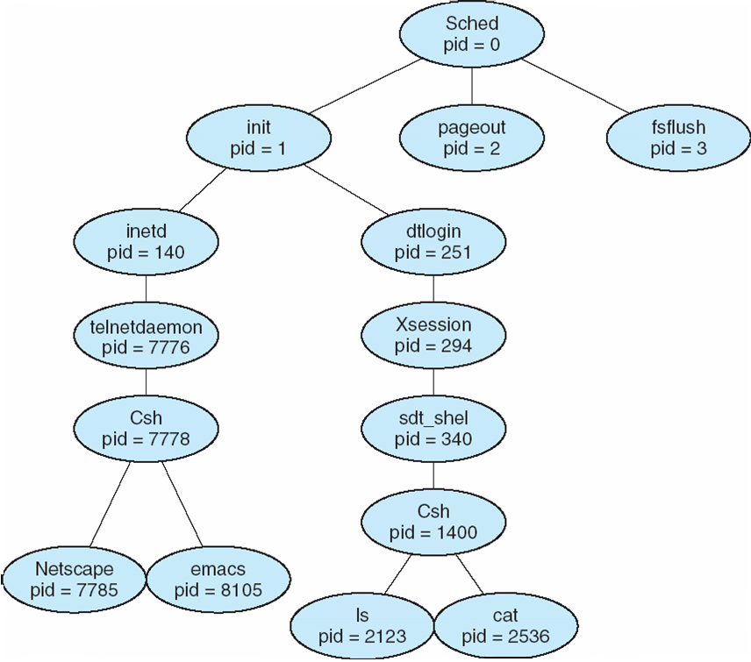
A tree of processes on a typical Solaris

Slide 30
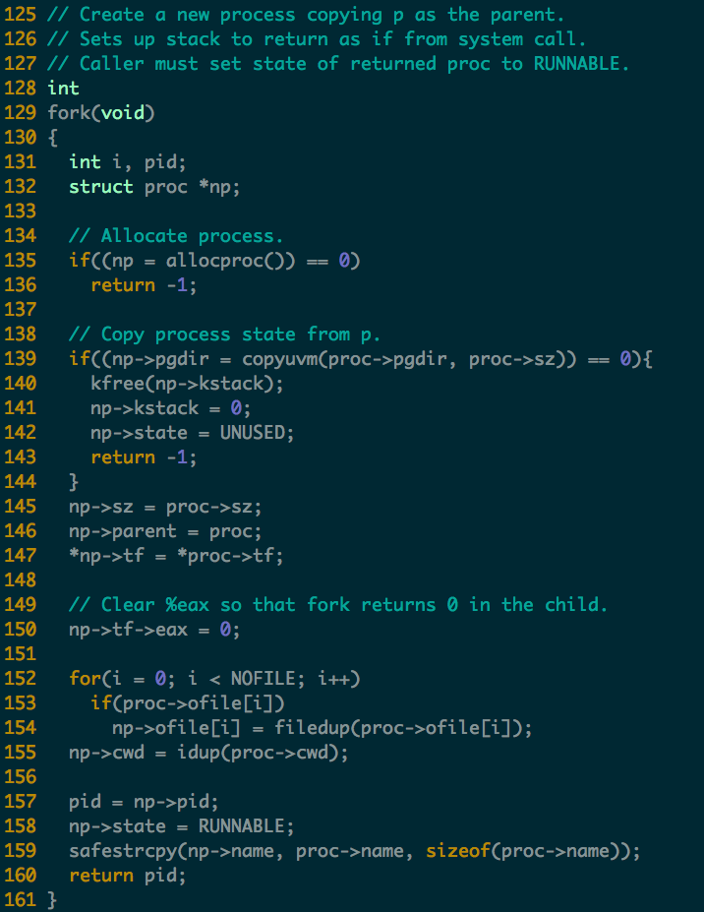
Process Creation in xv6
Read following code
allocproc()

Slide 31
Process Termination
Process executes last statement and asks the operating system to delete it (exit)
Output data from child to parent (via wait)
Process’ resources are deallocated by operating system
Parent may terminate execution of children processes (abort)
Child has exceeded allocated resources
Task assigned to child is no longer required

Slide 32
Process Termination (Cont.)
If parent is exiting
Some operating system do not allow child to continue if its parent terminates
All children terminated - cascading termination

Slide 33
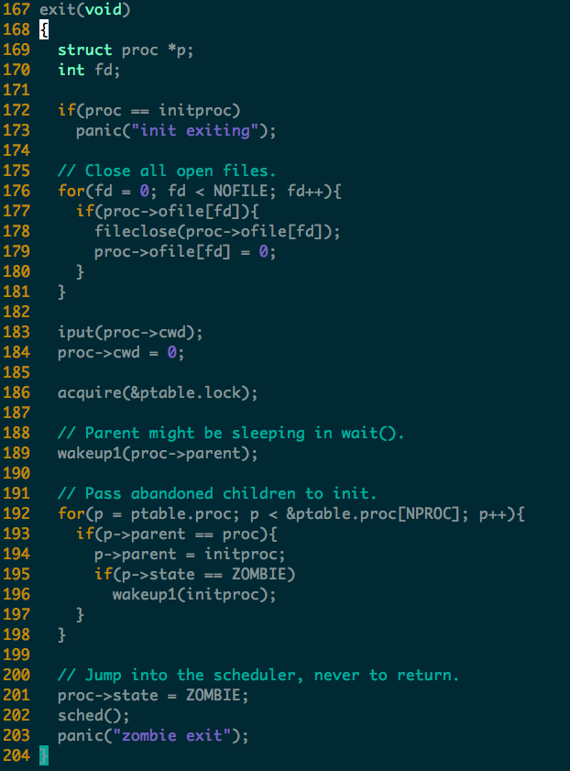

Slide 34
Homework
In xv6, one process contains only one thread. If we allow one process contains multiple thread, which state of the original PCB (process control block) should be per-thread and which should be per-process?

